Slide 1


Genetic parameters and genome-wide association studies of disease in growing pigs under a polymicrobial natural disease challenge
Usamah Kabuye
PhD student | Genetics and Genomics | Dr. Jack Dekkers’ lab
Animal Science Department
2025 NSIF Meeting October 14 - 16, Kansas City, MO

Slide 2
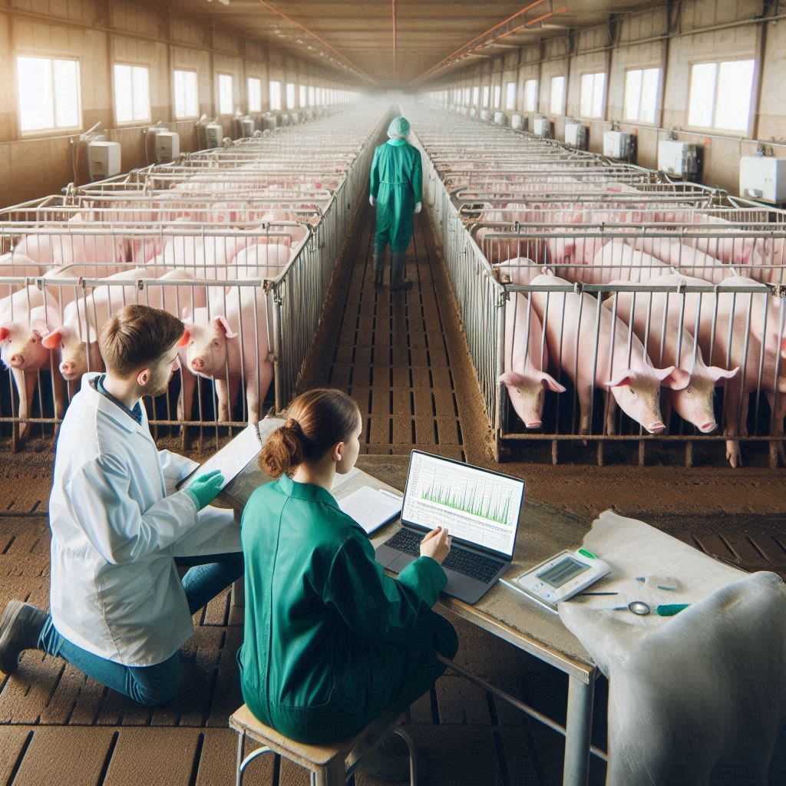
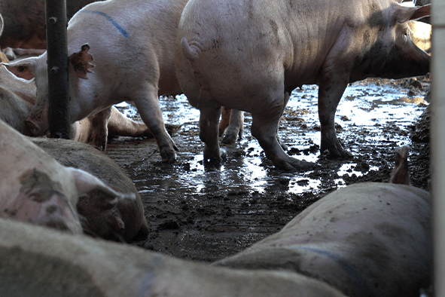





Introduction
Selection in most pig breeding programs is conducted in high-health nucleus herds, while pigs typically encounter multiple pathogens in commercial herds.
VS
A knowledge gap remains on genetic parameters and genomics of disease-related traits of growing pigs under a polymicrobial disease challenge.
Objective
Estimate genetic parameters and identify genomic regions and pathways associated with disease of growing pigs exposed to a natural polymicrobial disease challenge.
Department of Animal Science

Slide 3

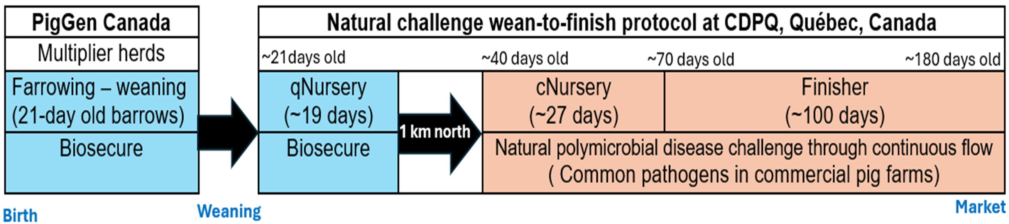
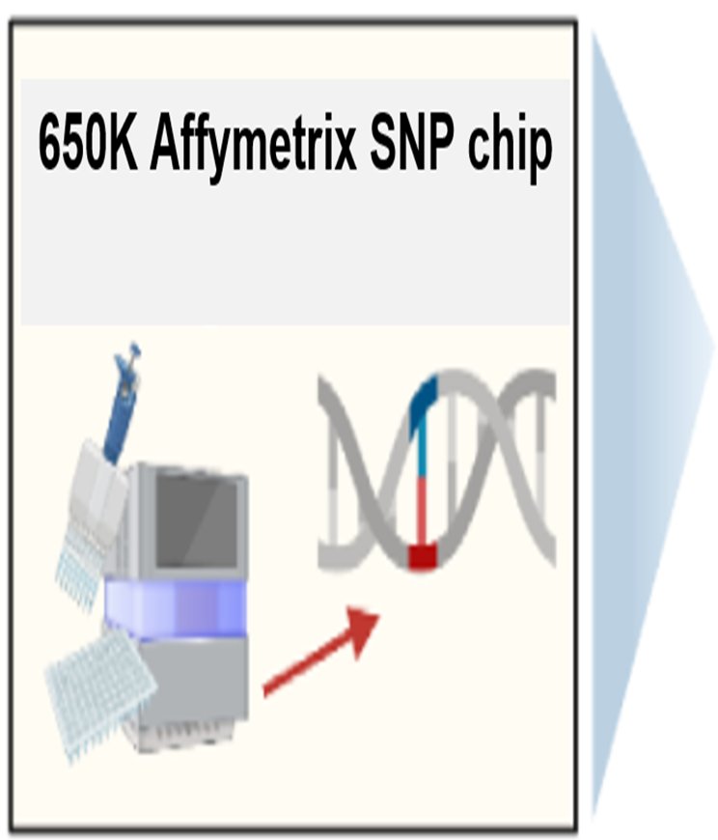
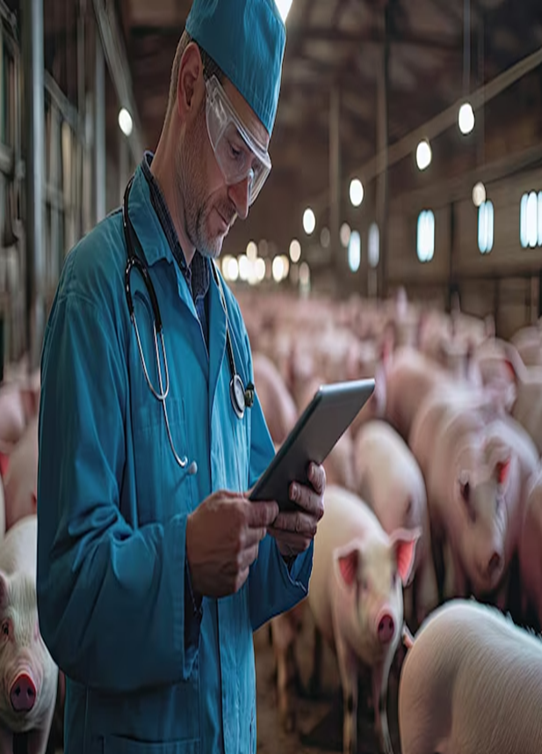
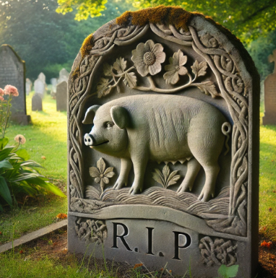


Materials and methods
A three-phase natural polymicrobial disease challenge (Putz et al.,2019, Frontiers in Genetics)
Disease resilience data collection
Animals and genotyping
4,095 Y × LR barrows
65 batches (each ~60 -75 pigs)
Phenotypic data - Individual health treatments and mortality records categorized as:
Meningitis
Respiratory distress
Scours
Unthriftiness
Other viral and/or bacterial infections
$h^{2}{, c}^{2}, {\hat{r}}_{g}$, GWAS, GSEA
Department of Animal Science

Slide 4
Key points
Respiratory distress treatment rate and mortality are substantially influenced by genetics, making it a key target for genetic selection.
Litter effects are critical in early life stages but diminish as the pigs mature.
Selection strategies to improve health treatment and mortality traits should be balanced to avoid unintended consequences.
GWAS and GSEA identified several genomic regions, candidate genes and enriched biological processes related to disease susceptibility and immune capacity.
Genetic parameters and genomics provide the roadmap for breeding programs, and this study provides valuable information to breed for disease resilience in pigs.
Manuscript under preparation
Department of Animal Science
Notes:
Gene set enrichment and pathway analyses identified several enriched biological processes, including disease susceptibility and immune capacity.

Slide 5




Acknowledgements
Co-authors:
John Harding
Michael Dyck
Frederic Fortin
Graham Plastow
PigGen Canada
Jack Dekkers
Funding from Genome Canada, Genome Alberta, Genome Prairie, PigGen Canada, USDA NIFA (2017-67007-26144), and the National Pork Board Survivability Project
Department of Animal Science

